Slide 1


Artificial Societies, Real Insights: AI Agents for Social Science Research
Mustafa Akben, Ph.D.
Assistant Professor of Management and Director of Artificial Intelligence Integration

Slide 2

Agenda
What is Agentic AI?
Applications of Agentic AI in Social Science
Hands-on Examples
Estimating Population-Level Relationships of Concepts
Creating an Agent-Based Interactive Simulation
Q&A

Slide 3

What is Agentic AI?
AI systems that can perceive, reason, and act autonomously in real or emulated social contexts to achieve specific goals.
Key Characteristics:
Goal-orientation
Autonomy (to some degree)
Adaptability
Social Interaction
Traditional AI (data analysis) vs. Agentic AI (active social participation and analysis).
Notes:
LLM-empowered agents conducting interviews or participating in online forums to gather social data (2022).

Slide 4
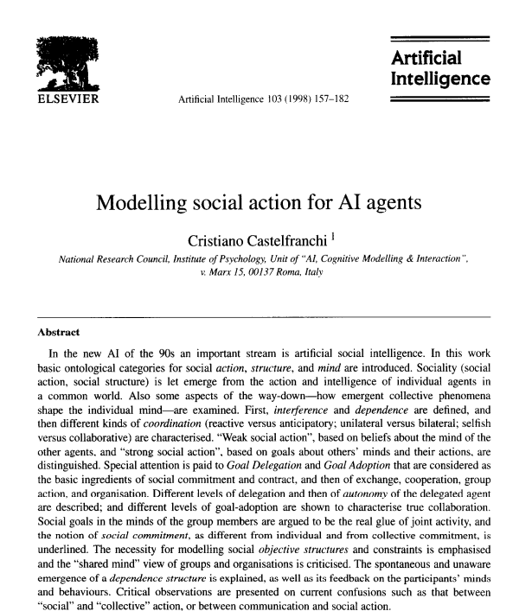
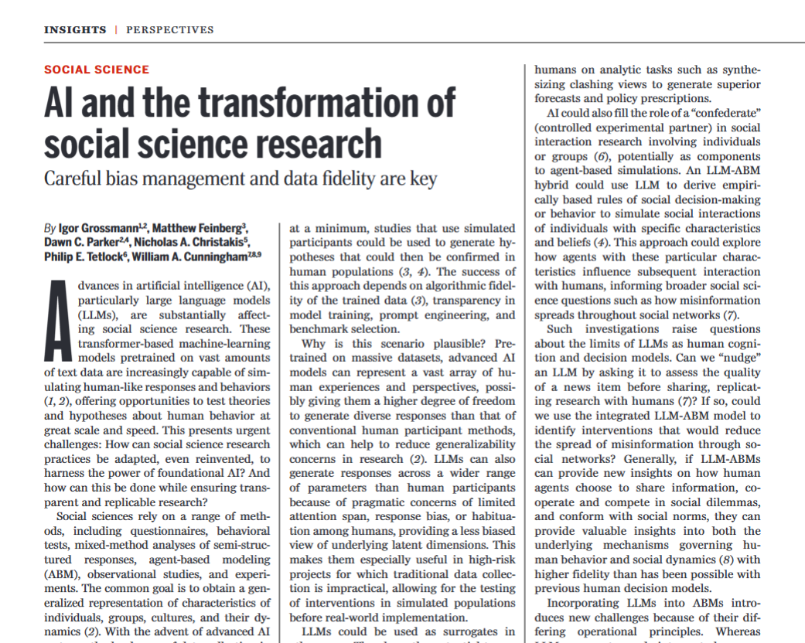

Slide 5
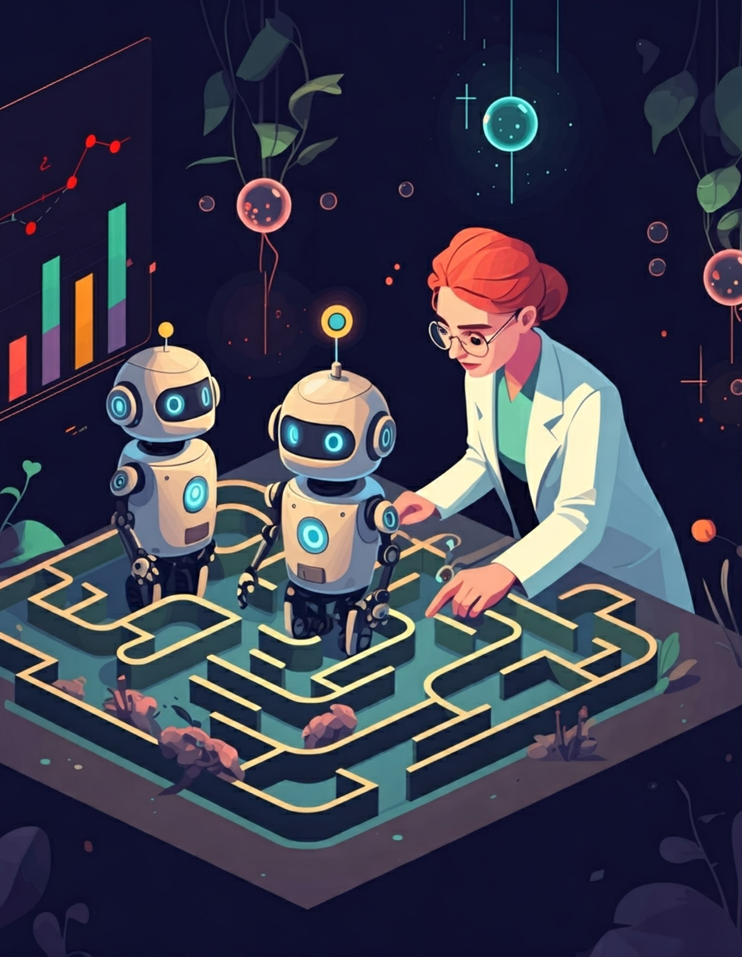
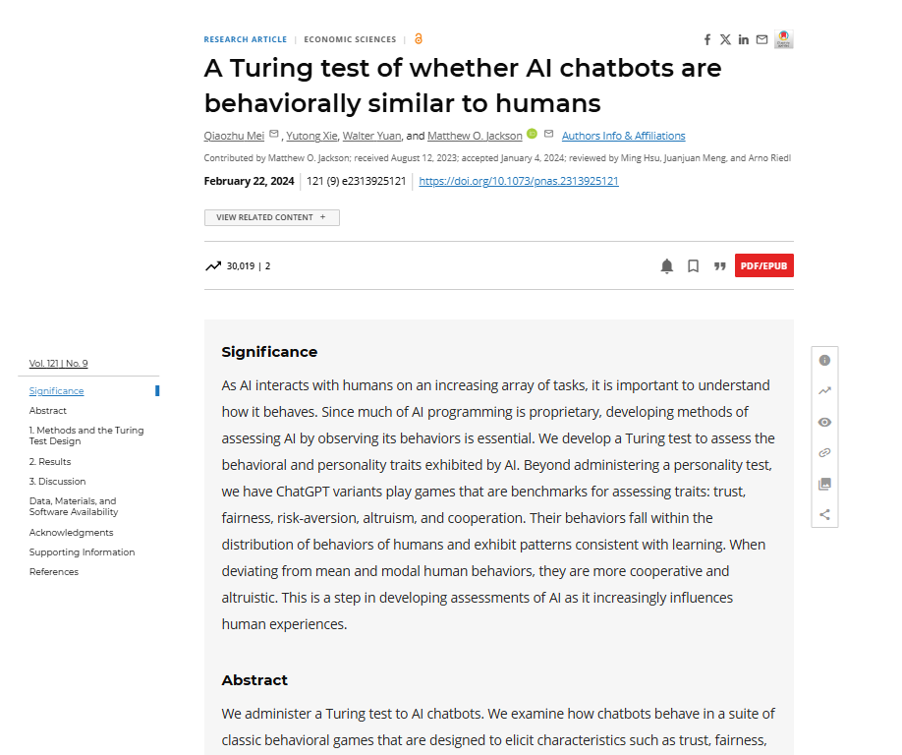
Agentic AI: Transforming Computational Social Science
AI agents as autonomous digital social researchers and participants
Agentic AI represents a leap forward in studying human behavior.
GPT-4’s ability to engage in complex social reasoning tasks (2023).

Slide 6

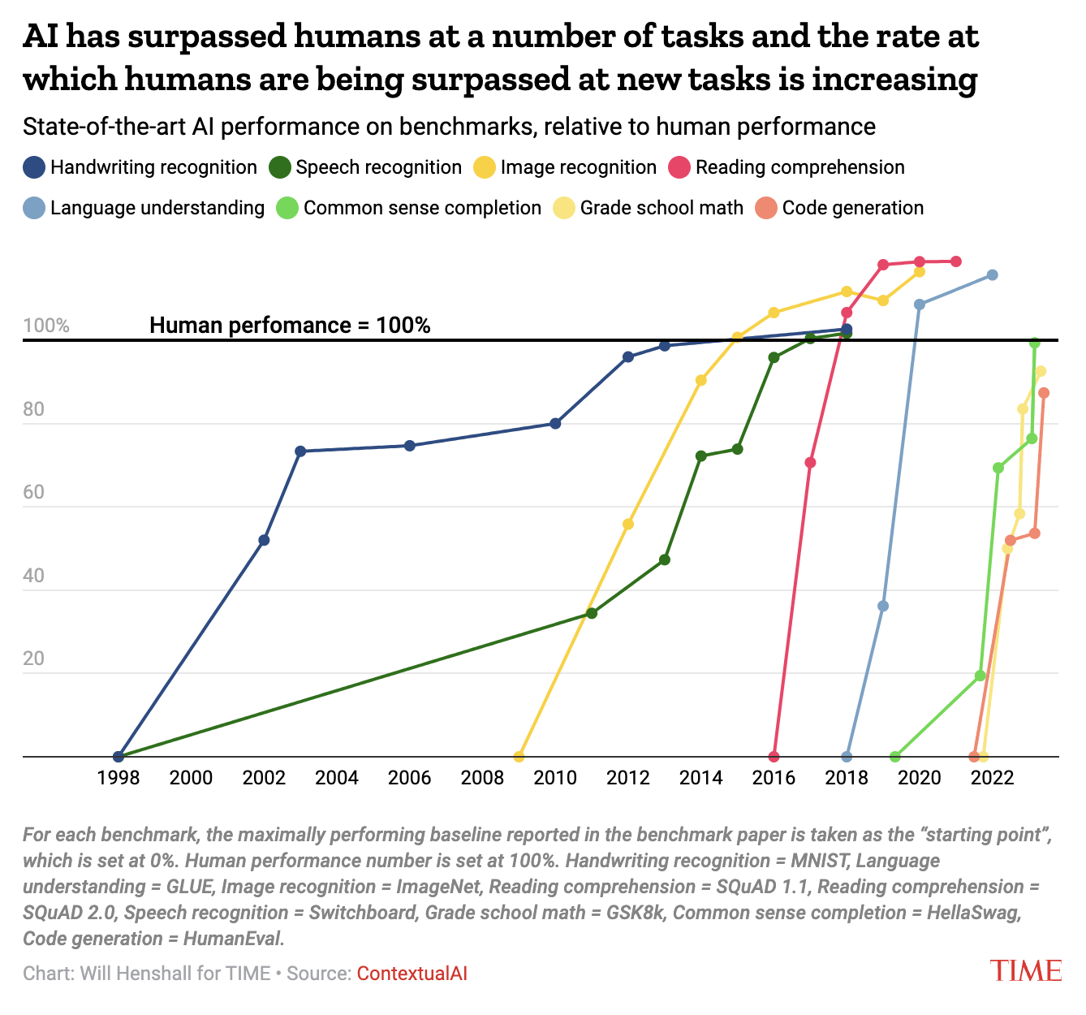

Slide 7
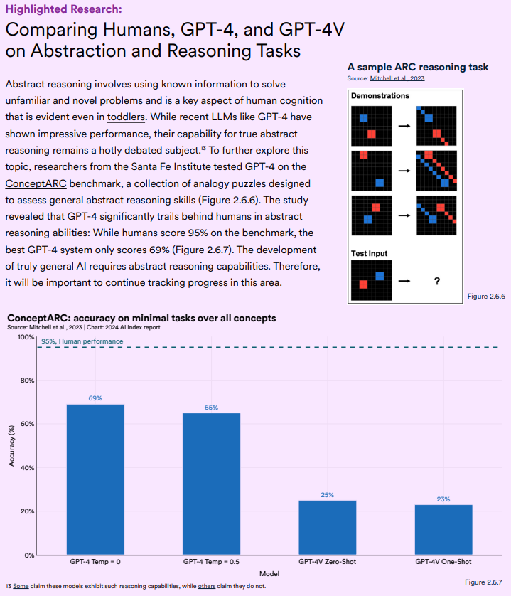

Slide 8
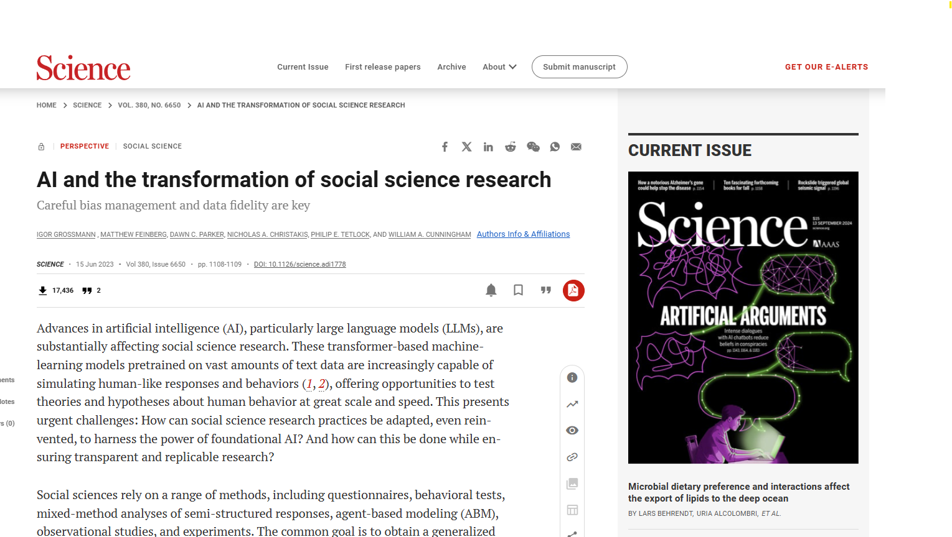

Slide 9
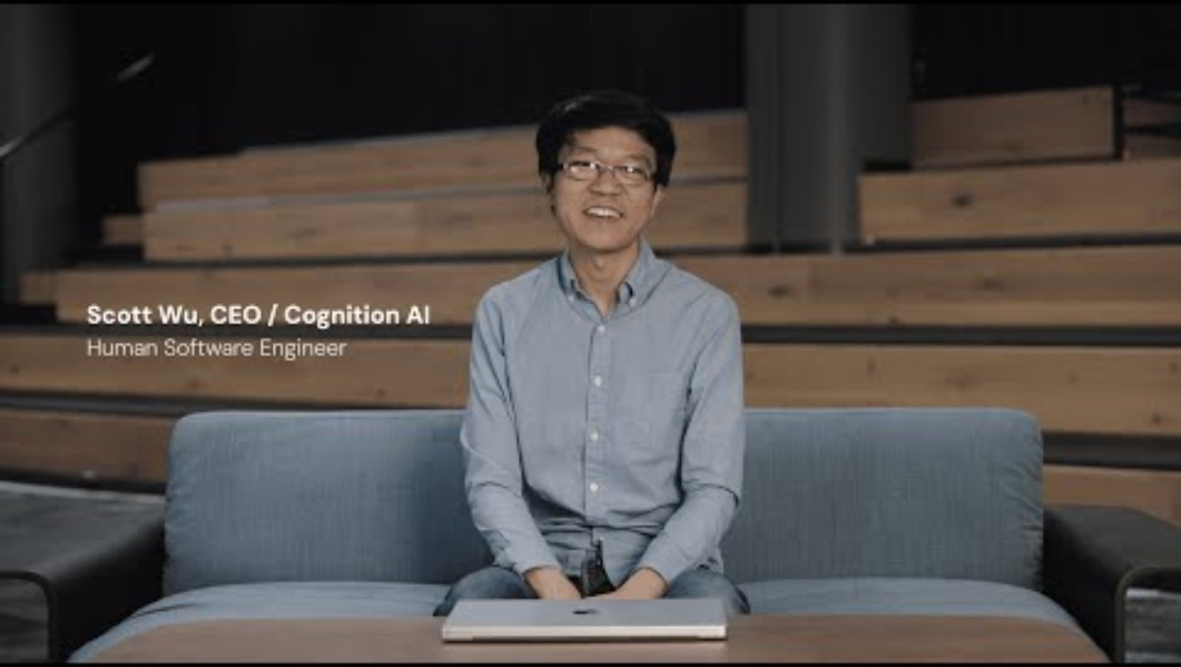

Slide 10

Core Components of Agentic AI
Goal-oriented behavior: Agents designed to pursue specific social science research objectives.
Autonomy: Ability to make independent decisions in complex social scenarios.
Adaptability: Learning from social interactions and adjusting research strategies.
Social Interaction: Engaging in meaningful dialogues with humans and other AI agents.

Slide 11

Key Technologies Enabling Agentic AI
Large Language Models: Powering sophisticated social reasoning and natural interactions.
Reinforcement Learning: Enabling agents to optimize research strategies in social environments.
Multi-modal AI: Integrating text, speech, and visual data for comprehensive social analysis.

Slide 12
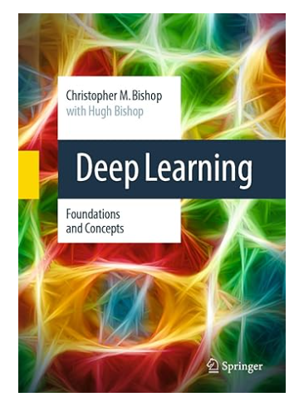
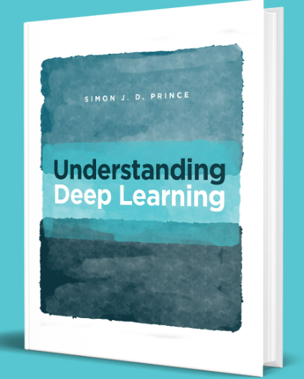
Why LLM and Deep Learning Works?

Slide 13
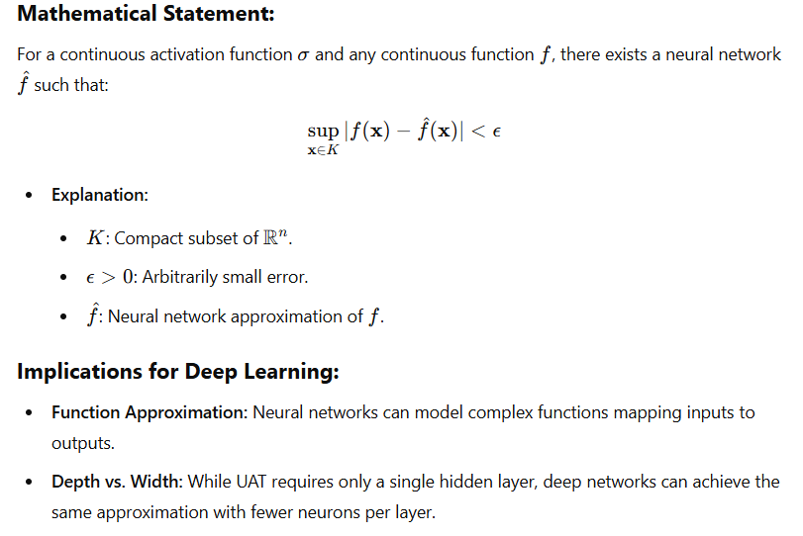
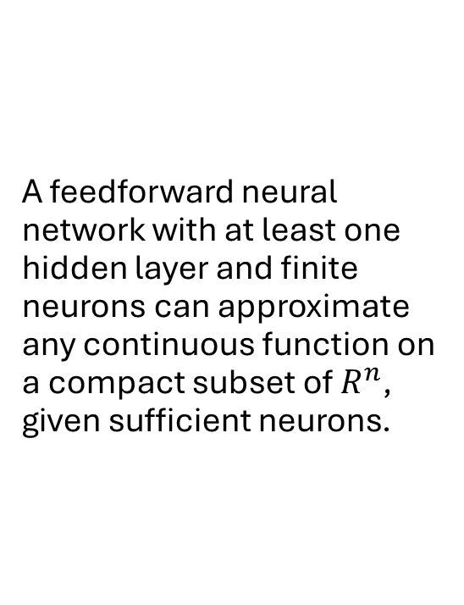
Universal Approximation Theorem (UAT):
A feedforward neural network with at least one hidden layer and finite neurons can approximate any continuous function on a compact subset of $R^{n}$, given sufficient neurons.

Slide 14
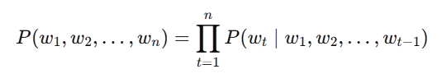
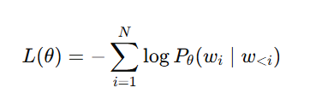
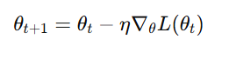
What is LLM?

Slide 15
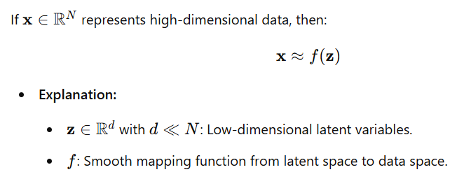
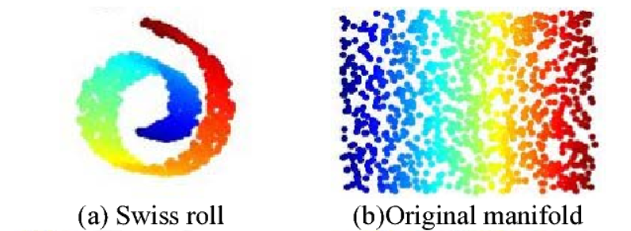
Manifold Theory

Slide 16

Agentic AI in Computational Social Science
AI become active participants and moderators in social research
Notes:
Example: AI agents participating in online forums to study emerging social movements (2024).

Slide 17

Application 1: Simulation of Human Responses
AI Agent can take survey and provide responses. LLMs have already demonstrated their ability to generate realistic survey responses concerning consumer behavior (Grossman et al., 2023)
Notes:
Example: AI agents tracking the spread of health misinformation across social media platforms (2023).

Slide 18
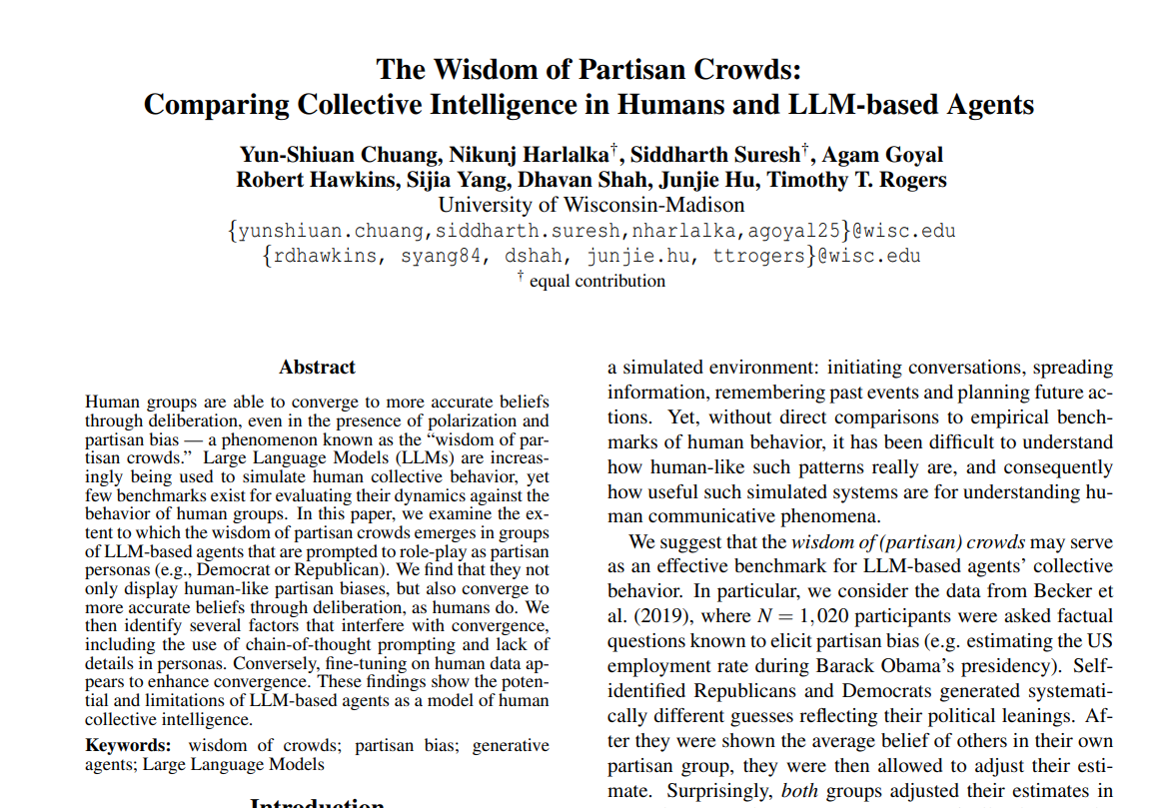

Slide 19
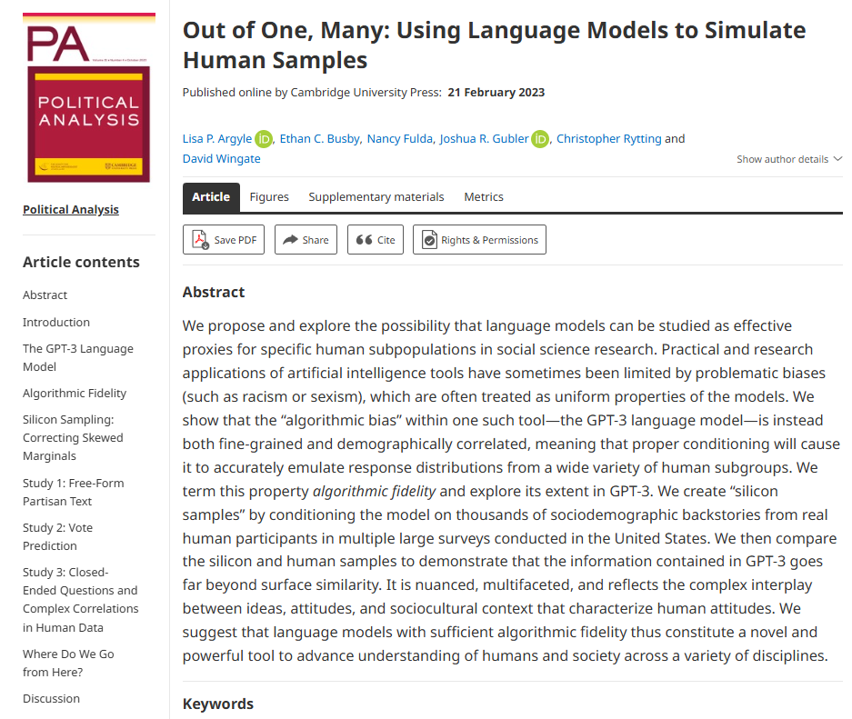

Slide 20

Application 2: Agent-Based Simulation with LLM
An AI agent can achieve specific objectives by acting in a defined role and providing insights into evolving social interactions.

Slide 21
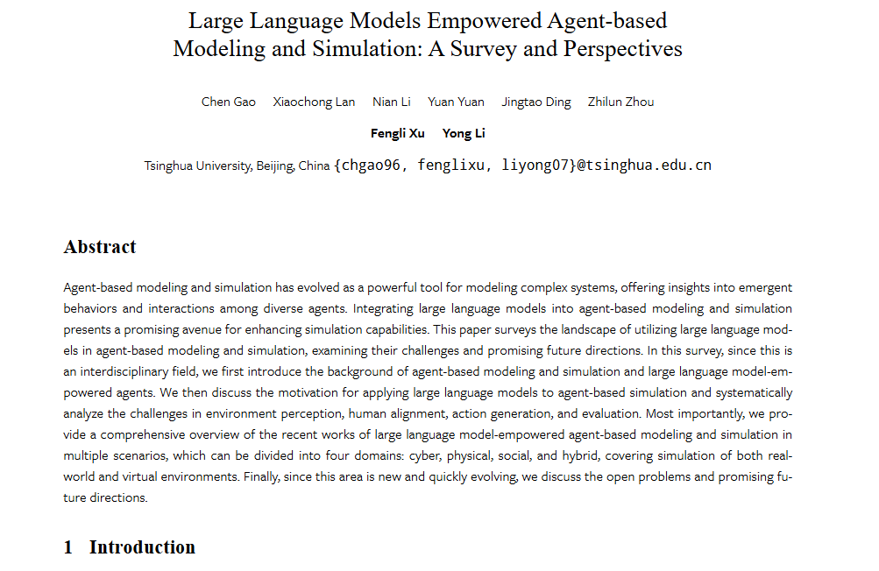

Slide 22

Notes:
https://youtu.be/ZdoU9vI2yCg?si=LeGsBm5BLmb027z4

Slide 23

Application 3: Participating Social Research
AI agents can act as confederates alongside the other human participants.

Slide 24
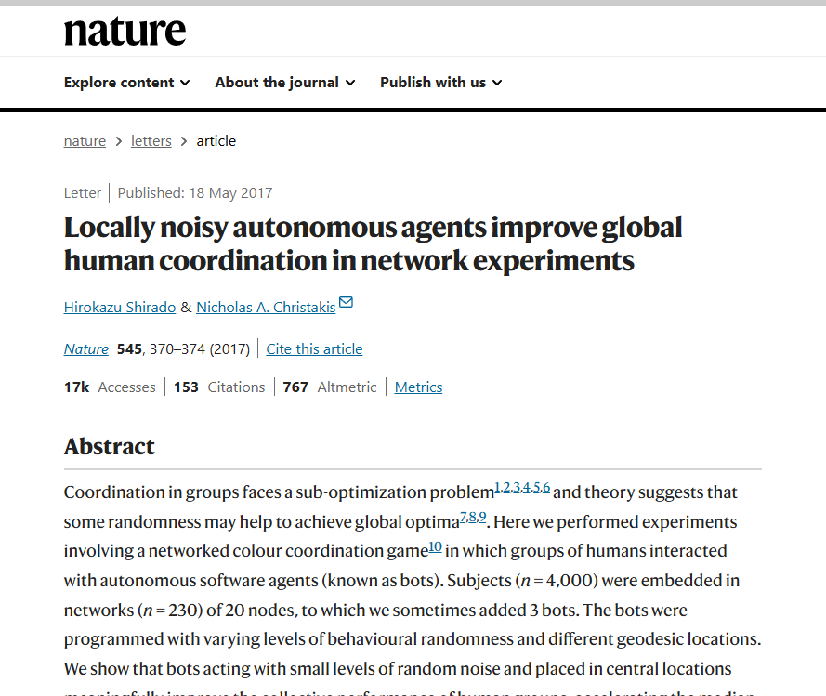

Slide 25

Application 4: Create Quantitative Data for “What ifs”?
An AI agent can complete a given vintage scenario based (Vignette ) on a different setup, producing rich interaction data for analysis.

Slide 26
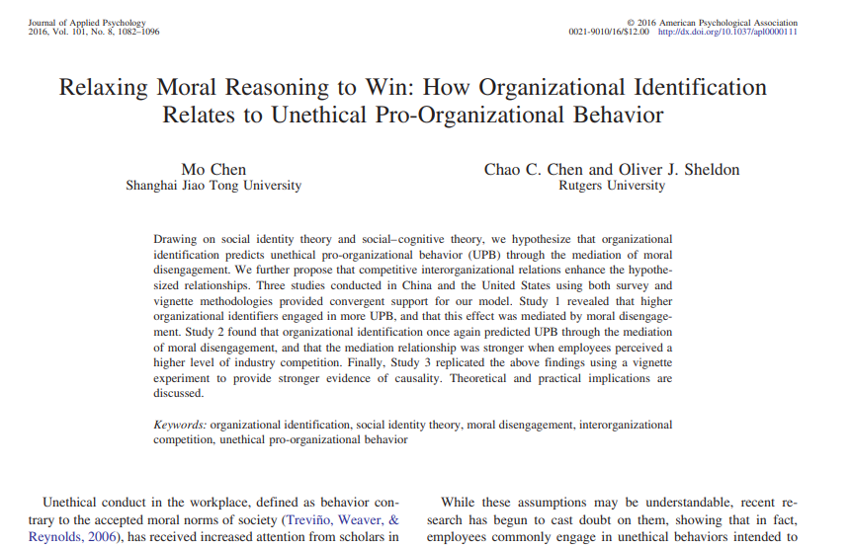

Slide 27
Vignette Example
Scenario:
You are a manager at a mid-sized tech company. One of your employees, Tom, has been consistently underperforming despite multiple attempts to help him improve. Recently, an HR manager from another company reached out to you for a recommendation for Tom, as he has applied for a position there.
You need to decide whether to provide a glowing recommendation for Tom. The context of your decision is framed within two different scenarios:
Cooperative Relationship: Your company has a strong, cooperative relationship with the other company. You often collaborate on projects and share resources. Providing a positive recommendation could strengthen this relationship further.
Competitive Relationship: Your company is in direct competition with the other company. You are both vying for the same clients and market share. Providing a positive recommendation could potentially weaken your competitor if Tom continues to underperform.

Slide 28

Hands-on Two Examples

Slide 29

Considerations in Agentic AI for Social Science
Algorithmic fidelity:
The quality of the AI-generated data depends on the fidelity of its training models. LLMs rely on vast amounts of textual data, and the accuracy of their outputs depends on the diversity and quality of these datasets​.
Transparency in model training:
LLMs’ training processes are often opaque, which can hinder the replicability of research and raise ethical concerns​.
Bias:
LLMs are trained on human-generated data, which inevitably contains sociocultural biases. Researchers must carefully manage these biases to prevent skewed results, particularly in studies with real-world applications​

Slide 30

Challenges and Limitations
Authenticity in Interactions: Ensuring AI agents can engage in genuinely insightful social exchanges.
Generalizability: Addressing limitations in applying AI-gathered insights to broader populations.

Slide 31

Conclusion
Democratizing Data Collection: AI systems, particularly LLMs, offer the potential to democratize data collection by providing access to more diverse and representative datasets. This could help address long-standing issues with sampling bias in social science research​.
Applications in High-Risk Scenarios: LLMs may be particularly useful in scenarios where human participation is impractical or unethical. For example, AI could be used to simulate human dynamics during space exploration or study online predators in a controlled, non-traumatizing environment​.
Changing Roles for Researchers: As AI becomes more integrated into social science research, new roles will emerge for researchers, such as managing AI biases, validating AI-generated data, and understanding human-AI interactions​ .

Slide 32

Q&A and Discussion
Any questions?

